Slide 1
Lesson 16 – Spring JDBC. Flyway

Slide 2
Lesson goals
Spring JdbcTemplate
Flyway
Notes:
2

Slide 3


Slide 4
Spring JdbcTemplate. Advantages
More convenient work with the database
Automatic release of resources
Transformation of exceptional situations of the DB into software
Flexible data access interface
Notes:
4

Slide 5
Spring JdbcTemplate. Disadvantages
Some very specific logic can be implemented only on low level (using connections and statements)
JdbcTemplate methods that work with class BeanPropertyRowMapper are slow because of reflection
Notes:
5

Slide 6
Spring JdbcTemplate. Who does what?
Action | Spring | You
Define connection parameters. |  | X
Open the connection. | X
Specify the SQL statement. |  | X
Declare parameters and provide parameter values |  | X
Prepare and execute the statement. | X
Set up the loop to iterate through the results (if any). | X
Do the work for each iteration. |  | X
Process any exception. | X
Handle transactions. | X
Close the connection, statement and resultset. | X
Notes:
6

Slide 7
Spring JdbcTemplate. Initialization
JDBCTemplate
@Configuration @PropertySource("classpath:database.properties") public class DatabaseConfig { @Bean public DataSource dataSource(@Value("${database.url}") String url, @Value("${database.username}") String username, @Value("${database.password}") String password) { final HikariConfig config = new HikariConfig(); config.setDriverClassName("org.postgresql.Driver"); config.setJdbcUrl(url); config.setUsername(username); config.setPassword(password); return new HikariDataSource(config); } @Bean public NamedParameterJdbcTemplate jdbcTemplate(DataSource dataSource) { return new NamedParameterJdbcTemplate(dataSource); } }
DataSource
DB
Notes:
7

Slide 8
Spring JdbcTemplate. Most Used Methods
void execute(String sql, Object... args); void query(String sql, RowCallbackHandler rch, Object... args); <T> List<T> query(String sql, RowMapper<T> rowMapper, Object... args); <T> T queryForObject(String sql, RowMapper<T> rowMapper, Object... args); <T> T queryForObject(String sql, Class<T> requiredType, Object... args); <T> List<T> queryForList(String sql, Class<T> elementType, Object... args); int update(String sql, Object... args); int[] batchUpdate(String... sql); int[] batchUpdate(String sql, List<Object[]> batchArgs);
Notes:
8

Slide 9
Spring JdbcTemplate. ResultSet
boolean next() throws SQLException; void close() throws SQLException; boolean wasNull() throws SQLException;
SomeType get**SomeType(int columnIndex) throws SQLException;
SomeType get**SomeType(String columnLabel) throws SQLException; Object getObject(String columnLabel) throws SQLException; <T> T getObject(String columnLabel, Class<T> type) throws SQLException; java.sql.Date getDate(String columnIndex) throws SQLException; java.sql.Timestamp getTimestamp(String columnIndex) throws SQLException; java.sql.Time getTime(String columnIndex) throws SQLException;
Notes:
9

Slide 10
Spring JdbcTemplate. RowMapper
@FunctionalInterface public interface RowMapper<T> { @Nullable T mapRow(ResultSet rs, int rowNum) throws SQLException; }
public User findBy(Integer id) { return jdbcTemplate.queryForObject( "SELECT firstName, lastName FROM users WHERE id = :userId", new MapSqlParameterSource("userId", id), (rs, rowNum) -> { User actor = new User(); actor.setFirstName(rs.getString("firstName")); actor.setLastName(rs.getString("lastName")); return actor; }); }
Notes:
10

Slide 11
Spring JdbcTemplate. BeanPropertyRowMapper
public User findByBPRM(Integer id) { return jdbcTemplate.queryForObject( "SELECT firstName, lastName FROM users WHERE id = :userId", new MapSqlParameterSource("userId", id), new BeanPropertyRowMapper<>(User.class) ); }
Notes:
11

Slide 12
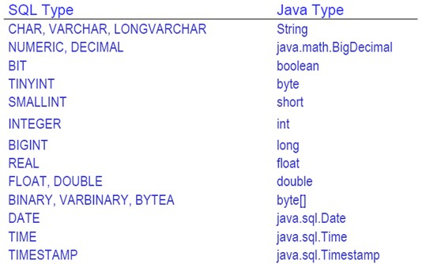
Mapping Java Types to SQL Types
Notes:
12

Slide 13
Spring JdbcTemplate. Benefits
JdbcTemplate supports ? (the same as PreparedStatement)
Prevents SQL Injections
Allows databases to create execution plan for your query
Makes SQL more readable inside the Java code
Create SQL queries by concatenation only if this is an only way to do this. Escape parameters that concatenated to SQL to avoid SQL Injections (better to use util methods from external libs)
Notes:
13

Slide 14

Notes:
14

Slide 15
Flyway
Database changes are called migrations.
Migrations can be written in SQL or Java
Versioned or Repeatable.
It has a Command-line client, a Java API and Gradle\Maven plugins .
Notes:
15

Slide 16
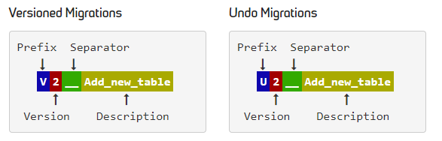
Flyway. Versioned migrations
V20210206101010__create_students_table
Applied in version order exactly once and can be undone
Notes:
16

Slide 17
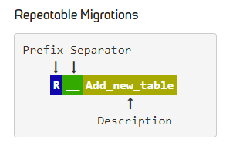
Flyway. Repeatable migrations
R__fix_invalid_data
Applied every time their checksum changes.
Always applied last, after versioned migrations have been executed.
Applied in the order of their description.
Flyway automatically discovers migrations on the filesystem and on the Java classpath.
To keep track of which migrations have already been applied when and by whom, Flyway adds a schema history table - schema_version (depends on Flyway version)
Notes:
17

Slide 18
Flyway. SQL Migrations
SQL-based migrations are typically used for
DDL changes (CREATE/ALTER/DROP statements for TABLES,VIEWS,TRIGGERS,SEQUENCES,…)
Simple reference data changes (CRUD in reference data tables)
Simple bulk data changes (CRUD in regular data tables)
Notes:
18

Slide 19
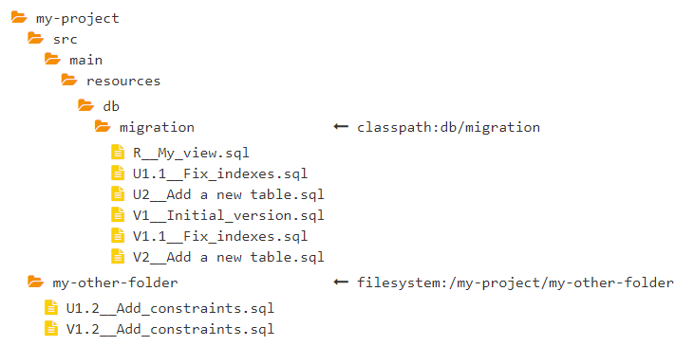
Flyway. Java Migrations
Java-based migrations are a great fit for all changes that can not easily be expressed using SQL.
These would typically be things like
BLOB & CLOB changes
Advanced bulk data changes (Recalculations, advanced format changes, …)
Notes:
19

Slide 20
plugins { id "org.flywaydb.flyway" version "7.5.2" }
Flyway. opt1 - Gradle Plugin
flywayMigrate | Migrates the database
flywayClean | Drops all objects in the configured schemas
flywayInfo | Prints the details and status information about all the migrations
flywayValidate | Validates the applied migrations against the ones available on the classpath
flywayUndo Flyway Teams | Undoes the most recently applied versioned migration
flywayBaseline | Baselines an existing database, excluding all migrations up to and including baselineVersion
flywayRepair | Repairs the schema history table
Notes:
20

Slide 21
Flyway. opt2 - Java API: Spring Framework
//DatabaseConfig.java @Bean public Flyway flyway(DataSource dataSource) { return Flyway.configure() .ignoreFutureMigrations(true) .ignoreMissingMigrations(true) .outOfOrder(true) .locations("classpath:db/migration") .dataSource(dataSource) .load(); } @Bean public InitializingBean flywayMigrate(Flyway flyway) { return flyway::migrate; }
Notes:
21

Slide 22
Flyway. opt3 - Java API: Spring Boot
#application.properties spring.flyway.enabled=true spring.flyway.baseline-on-migrate=true spring.flyway.locations=classpath:db/migrations
Notes:
22

Slide 23
Useful links
Accessing Relational Data using JDBC with Spring
Spring Jdbc
Spring Jdbc tutorial
Flyway
Notes:
23

Slide 24
Homework
Use Spring Jdbc and HikariCP in application instead of direct usage of connections, and statements;
Use Flyway to create database structure (and populate with data) on application startup;
Notes:
24

Slide 25
Thanks!
Any Questions?
25

